Slide 1
Ex-5 WORD COUNT MAP REDUCE PROGRAM

Slide 2
MAP REDUCE
MapReduce is a programming model for writing applications that can process Big Data in parallel on multiple nodes.
MapReduce provides analytical capabilities for analyzing huge volumes of complex data.
WORD COUNT PROBLEM
It is used to find out the frequency of each word.
The role of Mapper is to map the keys to the existing values and the role of Reducer is to aggregate the keys of common values.
So, everything is represented in the form of Key-value pair.

Slide 3
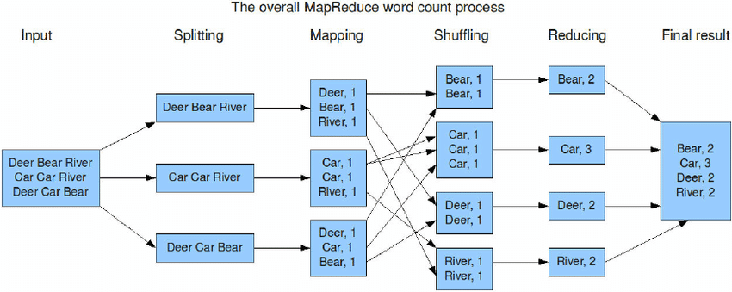
Example

Slide 4
Packages
import java.io.IOException;
import java.util.StringTokenizer;
import org.apache.hadoop.conf.Configuration;
import org.apache.hadoop.fs.Path;
import org.apache.hadoop.io.IntWritable;
import org.apache.hadoop.io.Text;
import org.apache.hadoop.mapreduce.Job;
import org.apache.hadoop.mapreduce.Mapper;
import org.apache.hadoop.mapreduce.Reducer;
import org.apache.hadoop.mapreduce.lib.input.FileInputFormat;
import org.apache.hadoop.mapreduce.lib.output.FileOutputFormat;

Slide 5
Mapper
public class WordCount {
public static class TokenizerMapper
extends Mapper<Object, Text, Text, IntWritable>{
private final static IntWritable one = new IntWritable(1);
private Text word = new Text();
public void map(Object key, Text value, Context context
) throws IOException, InterruptedException {
StringTokenizer itr = new StringTokenizer(value.toString());
while (itr.hasMoreTokens()) {
word.set(itr.nextToken());
context.write(word, one);
}
}
}

Slide 6
Reducer
public static class IntSumReducer
extends Reducer<Text,IntWritable,Text,IntWritable> {
private IntWritable result = new IntWritable();
public void reduce(Text key, Iterable<IntWritable> values,
Context context
) throws IOException, InterruptedException {
int sum = 0;
for (IntWritable val : values) {
sum += val.get();
}
result.set(sum);
context.write(key, result);
}
}

Slide 7
Driver
public static void main(String[] args) throws Exception {
Configuration conf = new Configuration();
Job job = Job.getInstance(conf, "word count");
job.setJarByClass(WordCount.class);
job.setMapperClass(TokenizerMapper.class);
job.setCombinerClass(IntSumReducer.class);
job.setReducerClass(IntSumReducer.class);
job.setOutputKeyClass(Text.class);
job.setOutputValueClass(IntWritable.class);
FileInputFormat.addInputPath(job, new Path(args[0]));
FileOutputFormat.setOutputPath(job, new Path(args[1]));
System.exit(job.waitForCompletion(true) ? 0 : 1);
}
}

Slide 8
Process
Wordcounttutorial/input_data/input.txt
Wordcounttutorial/wordcount.java
Wordcounttutorial/tutorial_classes

Slide 9
Reference
https://www.youtube.com/watch?v=6sK3LDY7Pp4
https://www.youtube.com/watch?v=uH5y6nTo_04

